Slide 1
NETFLIX CONTENT ANALYSIS DASHBOARD
Power BI Dashboard Presentation by
Brindha G (SA25PM035)
1 MBA
S.A. College of Arts and Science

Slide 2
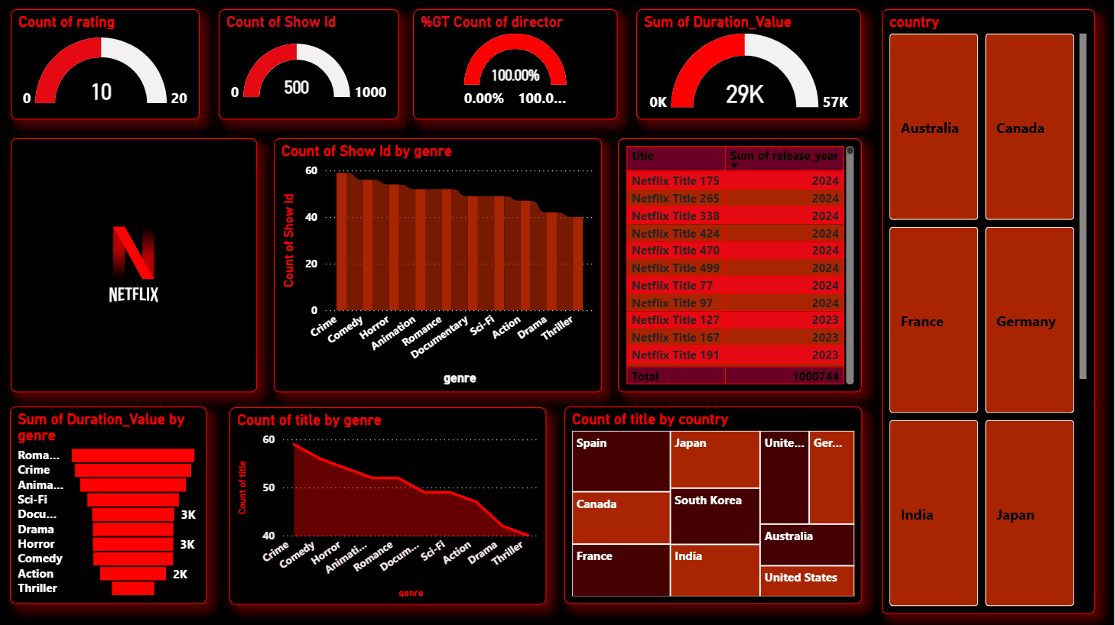

Slide 3
INTRODUCTION
This presentation provides insights from the Netflix Content Analysis Dashboard.
The dashboard analyzes Netflix content based on genre, country, duration, ratings, and trends.
It helps understand Netflix’s content strategy and global reach.

Slide 4
DATASET OVERVIEW
The dataset includes Movies and TV Shows available on Netflix.
Key attributes: Title, Genre, Country, Release Year, Rating, Duration, Director.
The data is cleaned and structured for analysis.

Slide 5
KEY PERFORMANCE INDICATORS
Count of Show ID: Total number of Netflix titles.
Count of Rating: Total rating categories used.
%GT Count of Director: Data completeness indicator.
Sum of Duration Value: Total content duration.

Slide 6
GENRE-WISE ANALYSIS
Drama has the highest number of titles and total duration.
Comedy and Documentary also show strong presence.
Action, Thriller, and Horror contribute moderately.

Slide 7
COUNTRY-WISE CONTENT DISTRIBUTION
The United States and India are the largest content contributors.
Countries like France, Germany, Japan, and Canada show moderate contributions.
This highlights Netflix’s strong global presence.

Slide 8
YEAR-WISE CONTENT TREND
Content production has increased significantly in recent years.
Peak growth observed between 2022 and 2024.
Indicates Netflix’s aggressive expansion strategy.

Slide 9
KEY INSIGHTS & CONCLUSION
Netflix focuses heavily on Drama and long-form content.
The platform shows continuous growth and global expansion.
The dashboard supports strategic decision-making for content investment.

Slide 10
THANK YOU

